Slide 1
Hash Tables
CS 46101 Section 600
CS 56101 Section 002
Dr. Angela Guercio
Spring 2010

Slide 2
Hash tables
Many applications require a dynamic set that supports only the dictionary operations INSERT, SEARCH, and DELETE. Example: a symbol table in a compiler.
A hash table is effective for implementing a dictionary.
The expected time to search for an element in a hash table is O(1), under some reasonable assumptions.
Worst-case search time is Θ(n), however.

Slide 3
Hash tables
A hash table is a generalization of an ordinary array.
With an ordinary array, we store the element whose key is k in position k of the array.
Given a key k, we find the element whose key is k by just looking in the kth position of the array. This is called direct addressing.
Direct addressing is applicable when we can afford to allocate an array with one position for every possible key.

Slide 4
Hash tables
We use a hash table when we do not want to (or cannot) allocate an array with one position per possible key.
Use a hash table when the number of keys actually stored is small relative to the number of possible keys.
A hash table is an array, but it typically uses a size proportional to the number of keys to be stored (rather than the number of possible keys).
Given a key k, don’t just use k as the index into the array.
Instead, compute a function of k, and use that value to index into the array. We call this function a hash function.

Slide 5
Hash tables
Issues that we’ll explore in hash tables:
How to compute hash functions. We’ll look at the multiplication and division methods.
What to do when the hash function maps multiple keys to the same table entry. We’ll look at chaining and open addressing.

Slide 6
Direct-address tables
Scenario
Maintain a dynamic set.
Each element has a key drawn from a universe U = {0; 1; . . .; m – 1} where m isn’t too large.
No two elements have the same key.
Represent by a direct-address table, or array, T [0 . . . m – 1]:
Each slot, or position, corresponds to a key in U.
If there’s an element x with key k, then T[k] contains a pointer to x.
Otherwise, T[k] is empty, represented by NIL.

Slide 7
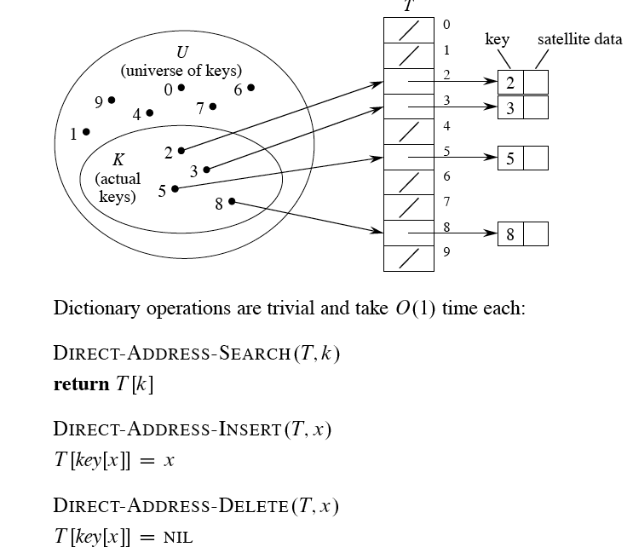
Direct-address tables

Slide 8
Hash tables
The problem with direct addressing is if the universe U is large, storing a table of size |U| may be impractical or impossible.
Often, the set K of keys actually stored is small, compared to U, so that most of the space allocated for T is wasted.
When K is much smaller than U, a hash table requires much less space than a direct-address table.
Can reduce storage requirements to Θ(|K|).
Can still get O(1)search time, but in the average case, not the worst case.

Slide 9
Hash tables
Idea
Instead of storing an element with key k in slot k, use a function h and store the element in slot h(k).
We call h a hash function.
h : U ➙ {0; 1; . . . ; m – 1}, so that h(k) is a legal slot number in T .
We say that k hashes to slot h(k).
Collisions
When two or more keys hash to the same slot.

Slide 10
Collisions
Can happen when there are more possible keys than slots (|U| > m).
For a given set K of keys with |K| ≤ m, may or may not happen. Definitely happens if |K| > m.
Therefore, must be prepared to handle collisions in all cases.
Use two methods: chaining and open addressing.
Chaining is usually better than open addressing. We’ll examine both.

Slide 11
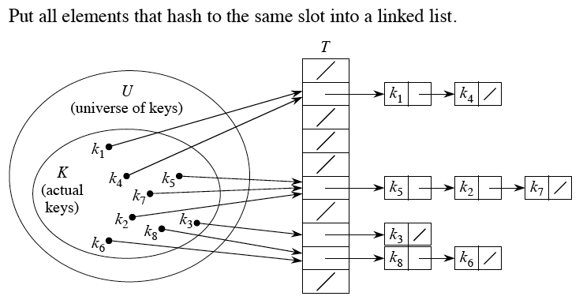
Collision resolution by chaining

Slide 12
Collision resolution by chaining
Insertion:
CHAINED-HASH-INSERT(T, x) insert x at the head of list T[h(key[x])]
Worst-case running time is O(1).
Assumes that the element being inserted isn’t already in the list.
It would take an additional search to check if it was already inserted.
Search:
CHAINED-HASH-SEARCH(T, k) search for an element with key k in list T[h(k)].
Running time is proportional to the length of the list of elements in slot h(k).
Deletion:
CHAINED-HASH-DELETE(T, x) delete x from the list T[h(key[x])]
Given pointer x to the element to delete, so no search is needed to find this element.
Worst-case running time is O(1) time if the lists are doubly linked.
If the lists are singly linked, then deletion takes as long as searching, because we must find x’s predecessor in its list in order to correctly update next pointers.

Slide 13
Analysis of hashing with chaining
Given a key, how long does it take to find an element with that key, or to determine that there is no element with that key?
Analysis is in terms of the load factor α = n / m.
n = # of elements in the table.
m = # of slots in the table = # of (possibly empty) linked lists.
Load factor is average number of elements per linked list.
Can have α < 1, α > 1 or α = 1.
Worst case is when all n keys hash to the same slot ⇒ get a single list of length n ⇒ worst-case time to search is θ(n), plus time to compute hash function.!
Average case depends on how well the hash function distributes the keys among the slots.

Slide 14
Analysis of hashing with chaining
We focus on average-case performance of hashing with chaining.
Assume simple uniform hashing: any given element is equally likely to hash into any of the m slots.
For j = 0, 1, …, m – 1, denote the length of list T[j] by n_{j} . Then n = n₀ + n₁ . + … + n_{m-1} .
Average value of n_{j} is E[n_{j} ] = α = n / m.
Assume that we can compute the hash function in O(1) time, so that the time required to search for the element with key k depends on the length n_{h(k)} of the list T[h(k)].

Slide 15
Analysis of hashing with chaining
We consider two cases:
If the hash table contains no element with key k, then the search is unsuccessful.
If the hash table does contain an element with key k, then the search is successful.

Slide 16
Unsuccessful search
Theorem
An unsuccessful search takes expected time θ(1 + α)
Proof
Simple uniform hashing ⇒ any key not already in the table is equally likely to hash to any of the m slots.
To search unsuccessfully for any key k, need to search to the end of the list T[h(k)]. This list has expected length E[n_{h(k)}] = α. Therefore, the expected number of elements examined in an unsuccessful search is α.
Adding in the time to compute the hash function, the total time required is θ(1 + α).

Slide 17
Successful search
The expected time for a successful search is also θ(1 + α).
The circumstances are slightly different from an unsuccessful search.
The probability that each list is searched is proportional to the number of elements it contains.
Theorem
A successful search takes expected time θ(1 + α).

Slide 18
Successful search
Proof
(omitted)

Slide 19
Hash functions
What makes a good hash function?
Ideally, the hash function satisfies the assumption of simple uniform hashing.
In practice, it’s not possible to satisfy this assumption, since we don’t know in advance the probability distribution that keys are drawn from, and the keys may not be drawn independently.
Often use heuristics, based on the domain of the keys, to create a hash function that performs well.

Slide 20
Keys as natural numbers
Hash functions assume that the keys are natural numbers.
When they’re not, have to interpret them as natural numbers.
Example: Interpret a character string as an integer expressed in some radix notation. Suppose the string is CLRS:
ASCII values: C = 67, L = 76, R = 82, S = 83.
There are 128 basic ASCII values.
So interpret CLRS as (67*128³) + (76*128²) + (82*128¹) + (83*128⁰)= 141,764,947.

Slide 21
Division method
h(k) = k mod m .
Example: m = 20 and k = 91 ⇒ h(k) = 11.
Advantage: Fast, since requires just one division operation.
Disadvantage: Have to avoid certain values of m:
Powers of 2 are bad. If m = 2^{p} for integer p, then h(k) is just the least significant p bits of k.
If k is a character string interpreted in radix 2^{p} (as in CLRS example), then m = 2^{p} -1 is bad: permuting characters in a string does not change its hash value (Exercise 11.3-3).
Good choice for m: A prime not too close to an exact power of 2.

Slide 22
Multiplication method
Choose constant A in the range 0 < A < 1.
Multiply key k by A.
Extract the fractional part of kA.
Multiply the fractional part by m.
Take the floor of the result.
Disadvantage: Slower than division method.
Advantage: Value of m is not critical.

Slide 23
(Relatively) easy implementation:
Choose m = 2^{p} for some integer p.
Let the word size of the machine be w bits.
Assume that k fits into a single word. (k takes w bits.)
Let s be an integer in the range 0 < s < 2^{w}. (s takes w bits.)
Restrict A to be of the form s/2^{w}.

Slide 24
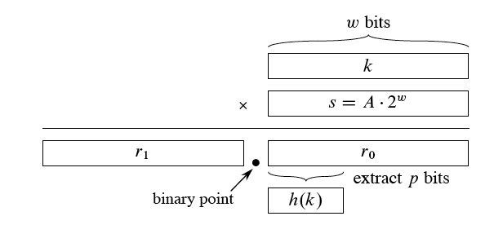
(Relatively) easy implementation:

Slide 25
(Relatively) easy implementation:
Multiply k by s.
Since we’re multiplying two w-bit words, the result is 2w bits, r₁2^{w}+r₀, where r₁ is the high-order word of the product and r₀ is the low-order word.
r₁ holds the integer part of kA (bkAc) and r₀ holds the fractional part of k A (k A mod 1 = k A – floor( k A)). Think of the “binary point” (analog of decimal point, but for binary representation) as being between r₁ and r₀ . Since we don’t care about the integer part of k A, we can forget about r₁ and just use r₀ .
Since we want floor( m (k A mod 1)), we could get that value by shifting r₀ to the left by p = lg m bits and then taking the p bits that were shifted to the left of the binary point.
We don’t need to shift. The p bits that would have been shifted to the left of the binary point are the p most significant bits of r₀ . So we can just take these bits after having formed r₀ by multiplying k by s.

Slide 26
Example
m = 8 (implies p = 3), w = 5, k = 21. Must have 0 < s < 25; choose s = 13 ⇒ A = 13/32.

Slide 27
How to choose A:
The multiplication method works with any legal value of A.
But it works better with some values than with others, depending on the keys being hashed.
Knuth suggests using A ≈ (√5 – 1)/2.

Slide 28
Universal hashing
Suppose that a malicious adversary, who gets to choose the keys to be hashed, has seen your hashing program and knows the hash function in advance. Then he could choose keys that all hash to the same slot, giving worst-case behavior.
One way to defeat the adversary is to use a different hash function each time. You choose one at random at the beginning of your program. Unless the adversary knows how you’ll be randomly choosing which hash function to use, he cannot intentionally defeat you.
Just because we choose a hash function randomly, that doesn’t mean it’s a good hash function. What we want is to randomly choose a single hash function from a set of good candidates.

Slide 29
Universal hashing
Consider a finite collection H of hash functions that map a universe U of keys into the range {0; 1; . . . ; m – 1}. H is universal if for each pair of keys k; l ∈U, where k ≠ l, the number of hash functions h ∈ H for which h(k) = h(l) is ≤ |H |/m.
Put another way, H is universal if, with a hash function h chosen randomly from H , the probability of a collision between two different keys is no more than than 1/m chance of just choosing two slots randomly and independently.

Slide 30
Universal hashing
Why are universal hash functions good?
They give good hashing behavior:
Theorem: Using chaining and universal hashing on key k:
If k is not in the table, the expected length E[n_{h(k)}] of the list that k hashes to is ≤ α.
If k is in the table, the expected length E[n_{h(k)}] of the list that holds k is ≤ α + 1.
Corollary Using chaining and universal hashing, the expected time for each SEARCH operation is O(1).
They are easy to design.

Slide 31
Open addressing
An alternative to chaining for handling collisions.
Idea
Store all keys in the hash table itself.
Each slot contains either a key or NIL.
To search for key k:
Compute h(k) and examine slot h(k). Examining a slot is known as a probe.
If slot h(k) contains key k, the search is successful. If this slot contains NIL, the search is unsuccessful.
There’s a third possibility: slot h(k) contains a key that is not k. We compute the index of some other slot, based on k and on which probe (count from 0: 0th, 1st, 2nd, etc.) we’re on.
Keep probing until we either find key k (successful search) or we find a slot holding NIL (unsuccessful search).

Slide 32
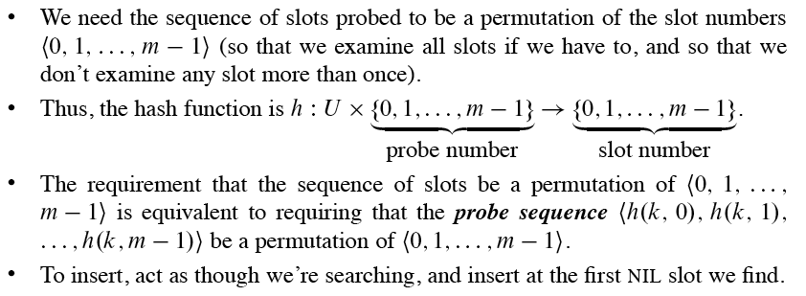
Open addressing

Slide 33
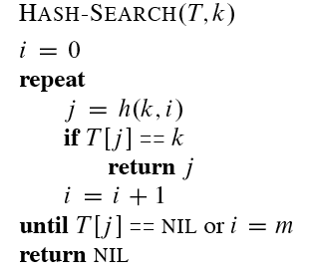
Pseudocode for searching
HASH-SEARCH returns the index of a slot containing key k, or NIL if the search is unsuccessful.

Slide 34
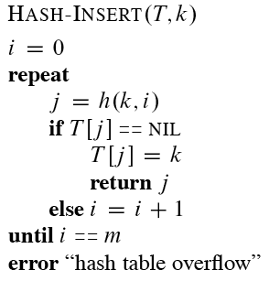
Pseudocode for insertion
HASH-INSERT returns the number of the slot that gets key k, or it flags a “hash table overflow” error if there is no empty slot in which to put key k.

Slide 35
Deletion
Cannot just put NIL into the slot containing the key we want to delete.
Suppose we want to delete key k in slot j .
And suppose that sometime after inserting key k, we were inserting key k₀, and during this insertion we had probed slot j (which contained key k).
And suppose we then deleted key k by storing NIL into slot j .
And then we search for key k₀.
During the search, we would probe slot j before probing the slot into which key k₀was eventually stored.
Thus, the search would be unsuccessful, even though key k₀is in the table.

Slide 36
Deletion
Solution: Use a special value DELETED instead of NIL when marking a slot as empty during deletion.
Search should treat DELETED as though the slot holds a key that does not match the one being searched for.
Insertion should treat DELETED as though the slot were empty, so that it can be reused.
The disadvantage of using DELETED is that now search time is no longer dependent on the load factor α.

Slide 37
How to compute probe sequences
The ideal situation is uniform hashing: each key is equally likely to have any of the m! permutations of <0; 1; . . .; m -1> as its probe sequence. (This generalizes simple uniform hashing for a hash function that produces a whole probe sequence rather than just a single number.)
It’s hard to implement true uniform hashing, so we approximate it with techniques that at least guarantee that the probe sequence is a permutation of <0; 1; . . .; m -1>.
None of these techniques can produce all m! probe sequences. They will make use of auxiliary hash functions, which map U → {0; 1; . . .; m -1}.

Slide 38
Linear probing
Given auxiliary hash function h’, the probe sequence starts at slot h’(k) and continues sequentially through the table, wrapping after slot m - 1 to slot 0.
Given key k and probe number i (0 ≤ i < m), h(k; I) = (h’(k) + i) mod m.
The initial probe determines the entire sequence ⇒ only m possible sequences.
Linear probing suffers from primary clustering: long runs of occupied sequences build up. And long runs tend to get longer, since an empty slot preceded by i full slots gets filled next with probability (i + 1)/m. Result is that the average search and insertion times increase.

Slide 39
Quadratic probing
As in linear probing, the probe sequence starts at h’(k). Unlike linear probing, it jumps around in the table according to a quadratic function of the probe number: h(k; i) = (h’(k) + c₁i + c₂i² ) mod m, where c₁; c₂ ≠ 0 are constants.
Must constrain c₁, c₂ , and m in order to ensure that we get a full permutation of <0; 1; . . .; m -1>. (Problem 11-3 explores one way to implement quadratic probing.)
Can get secondary clustering: if two distinct keys have the same h’ value, then they have the same probe sequence.

Slide 40
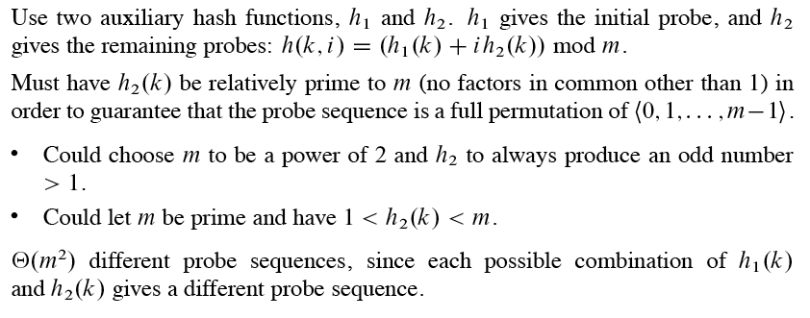
Double hashing

Slide 41
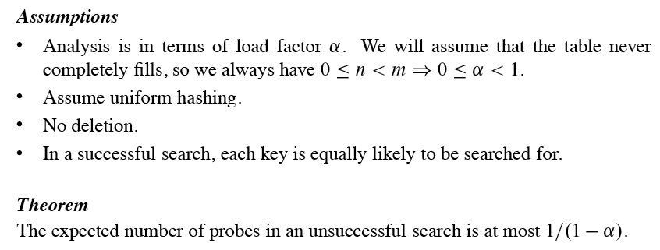
Analysis of open-address hashing

Slide 42
Next
Chapter 12 - Binary Search Trees

